Slide 1
How to;
Multimedia for Education
2018310524 백경현

Slide 2
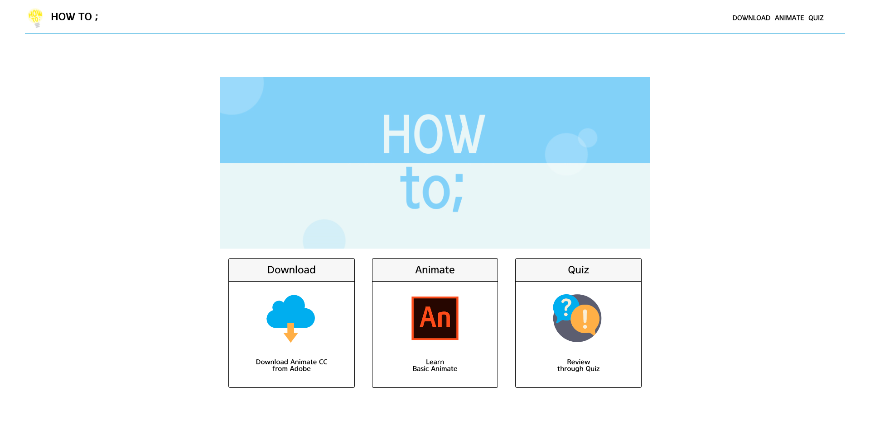
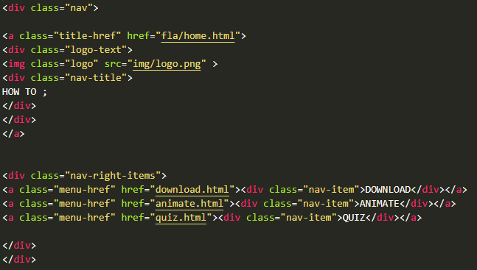
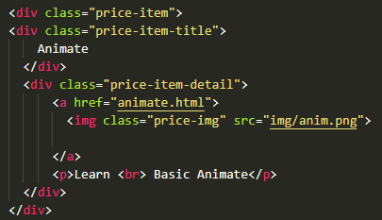
HOME
Navigating Menu

Slide 3
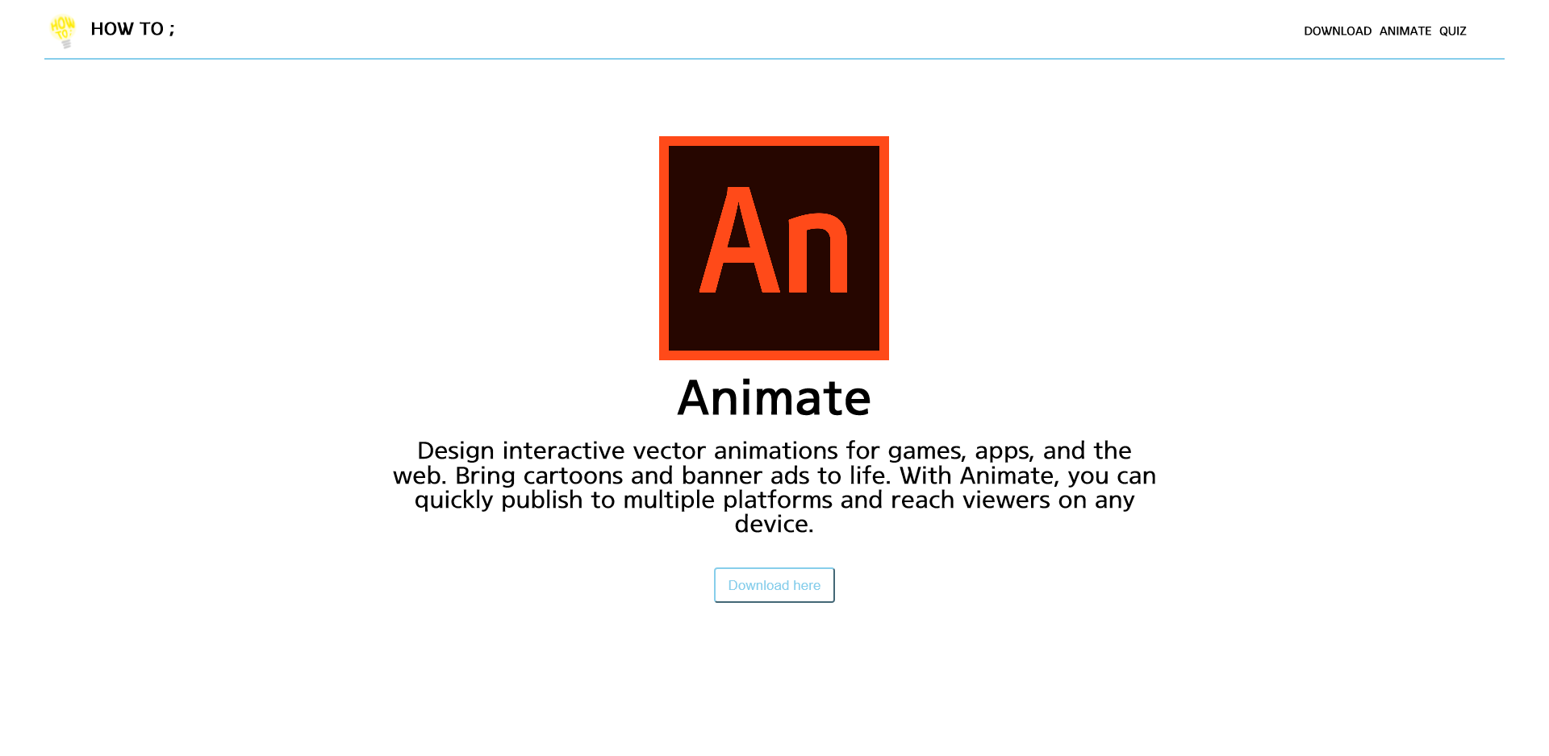
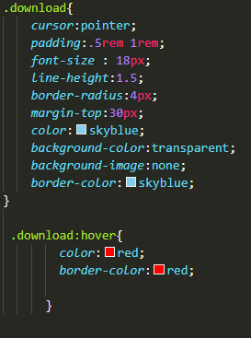
DOWNLOAD
Button - CSS

Slide 4
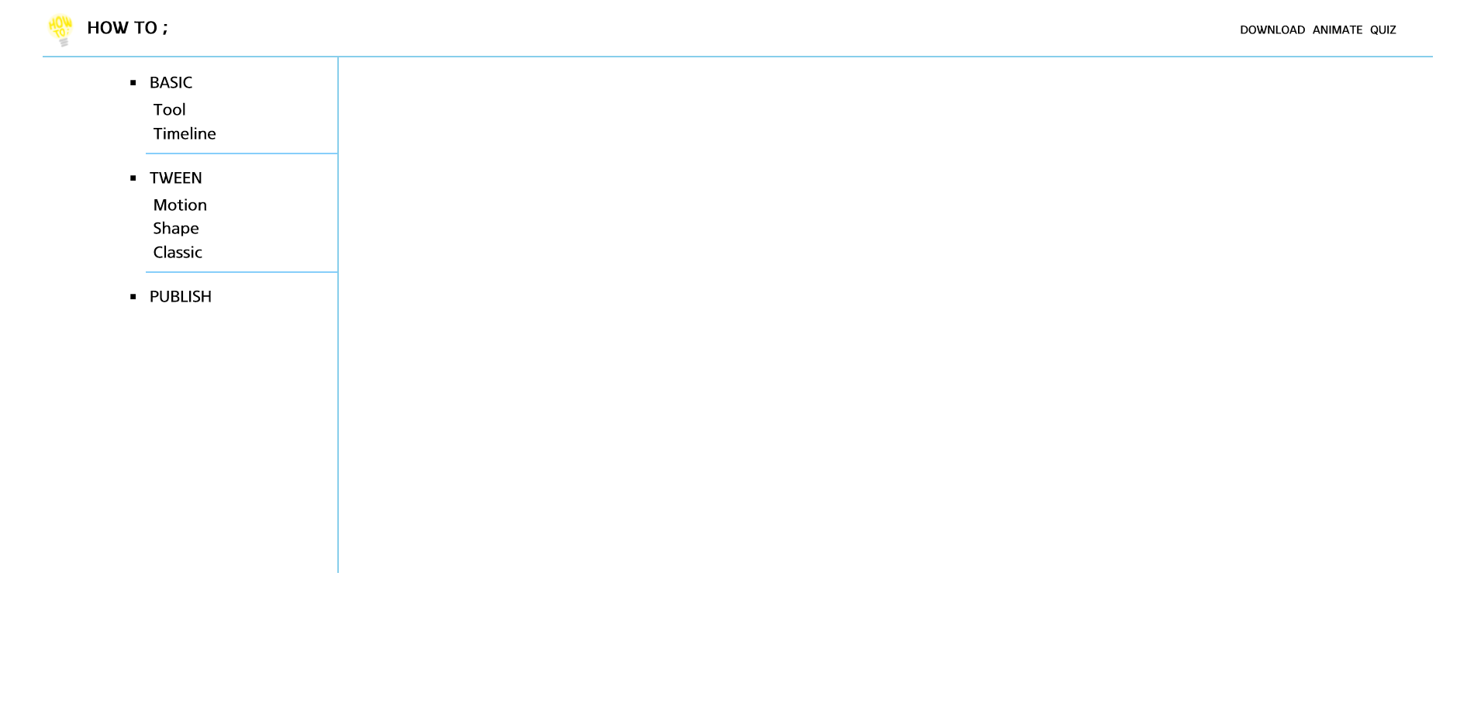
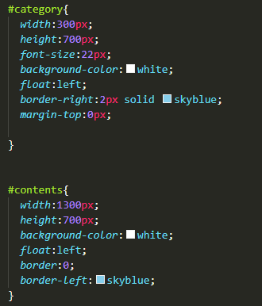

ANIMATE
Divide section
-<div>
Call html

Slide 5
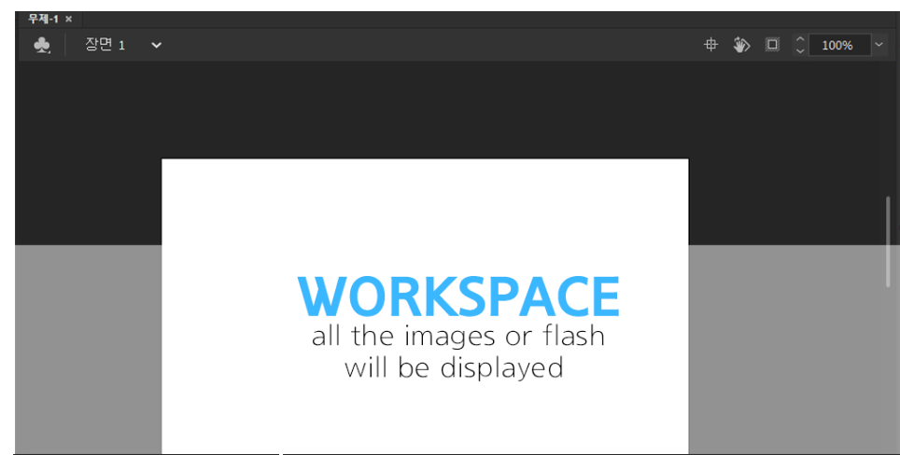
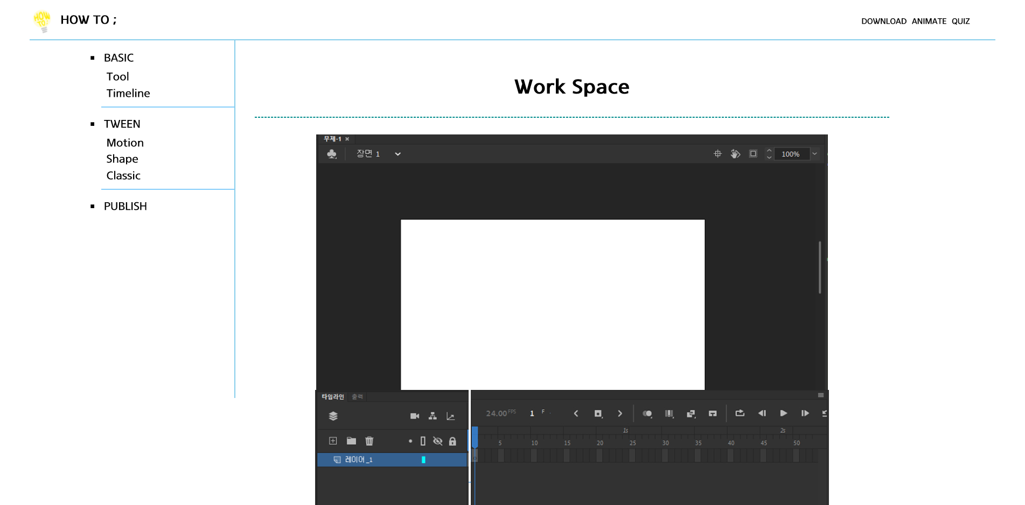
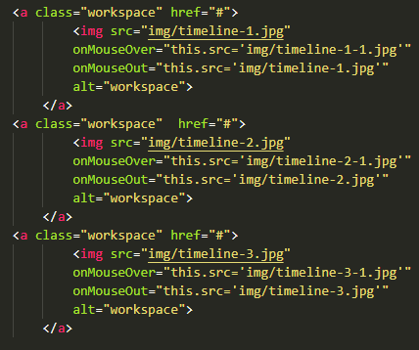
Basic
MouseOver / Out

Slide 6
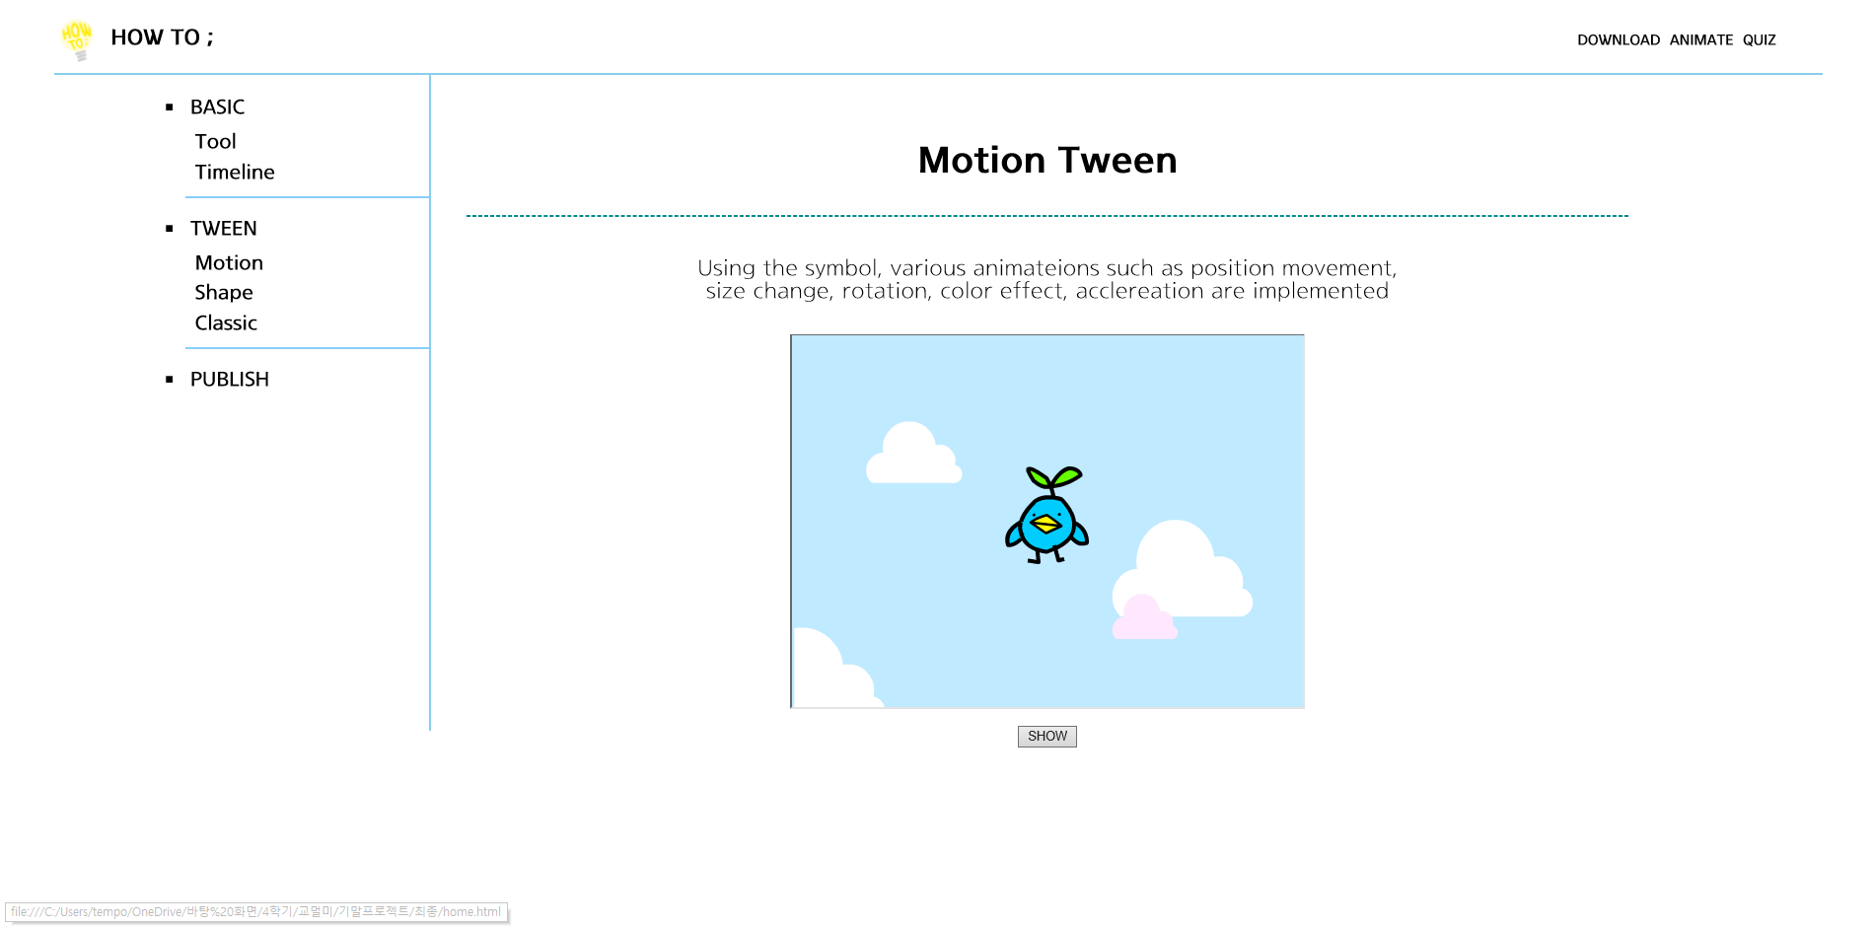



Tween
Motion Tween | Shape Tween | Classic Tween
SHOW / HIDE

Slide 7
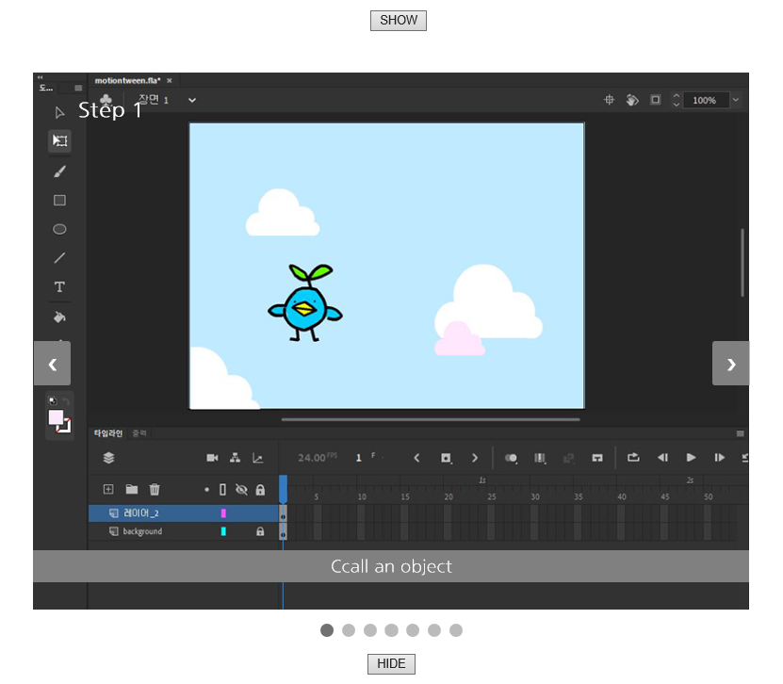
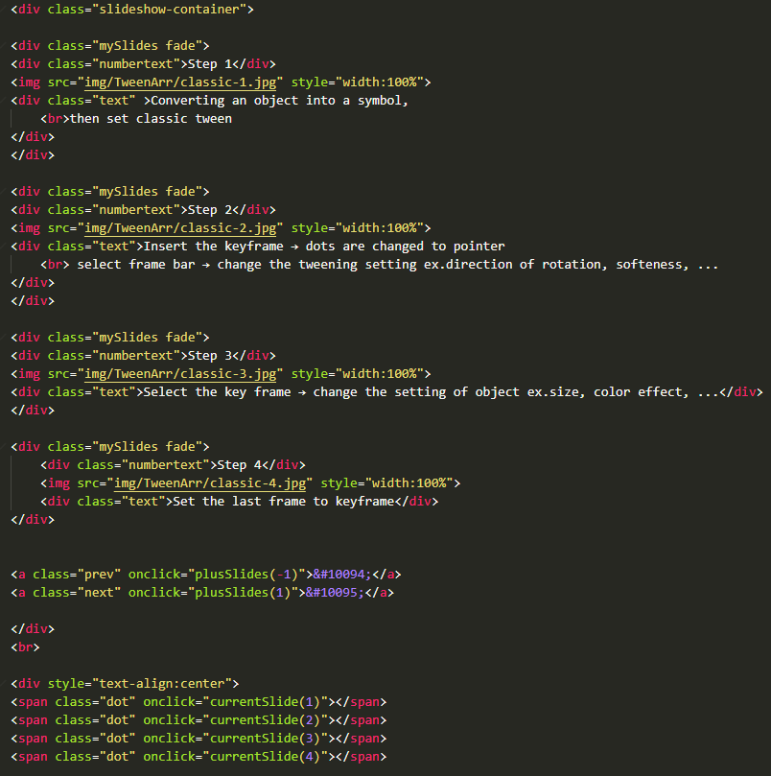
Tween
Motion Tween | Shape Tween | Classic Tween
Slide Show - HTML

Slide 8
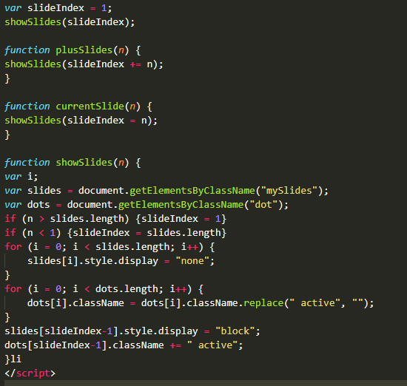
Tween
Motion Tween | Shape Tween | Classic Tween
Slide Show - JS

Slide 9
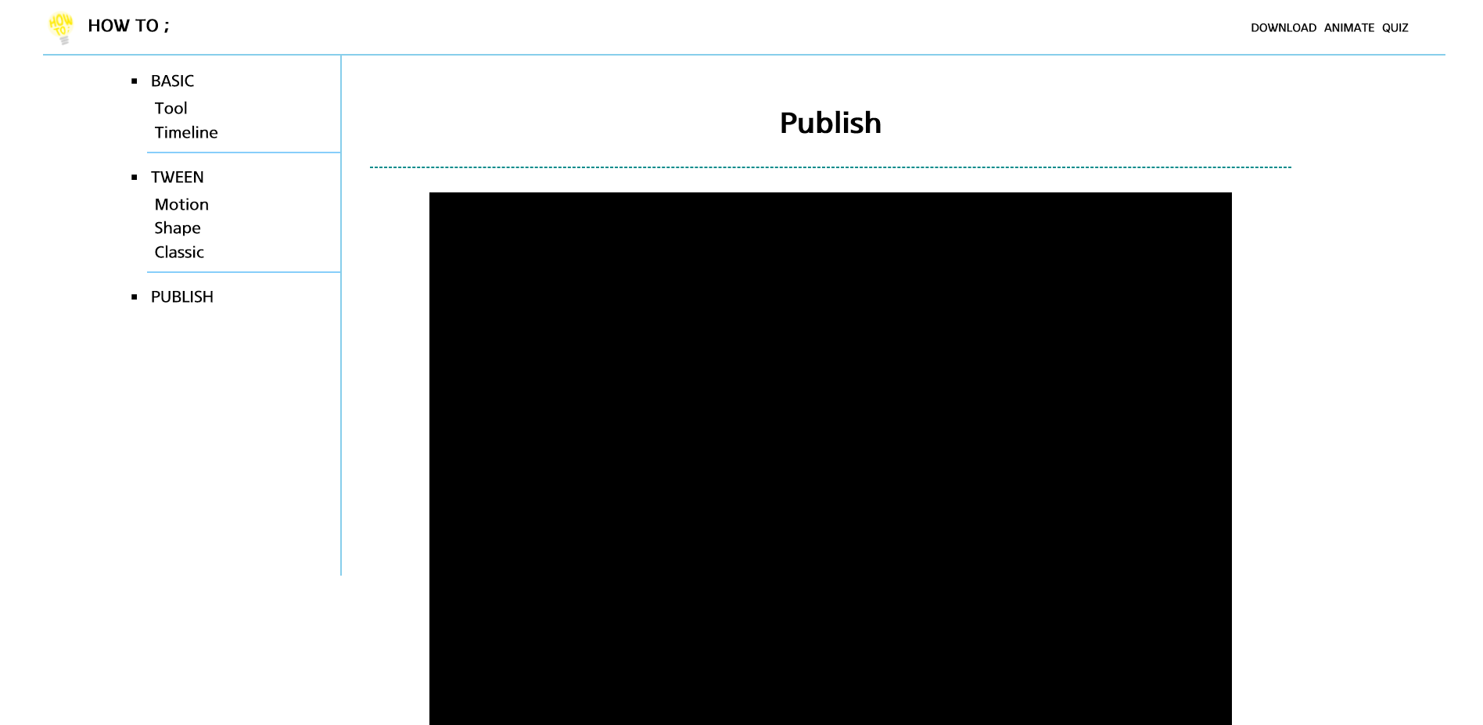

Publishing
Video

Slide 10
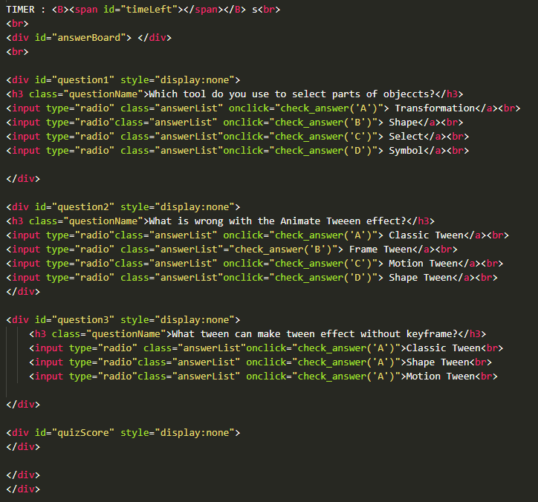
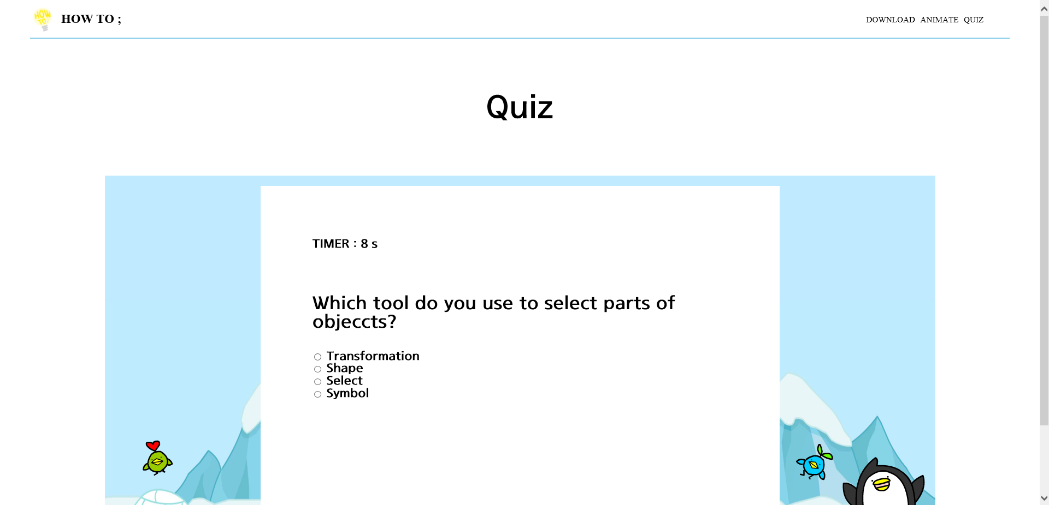
Quiz
Time out Quiz - HTML

Slide 11
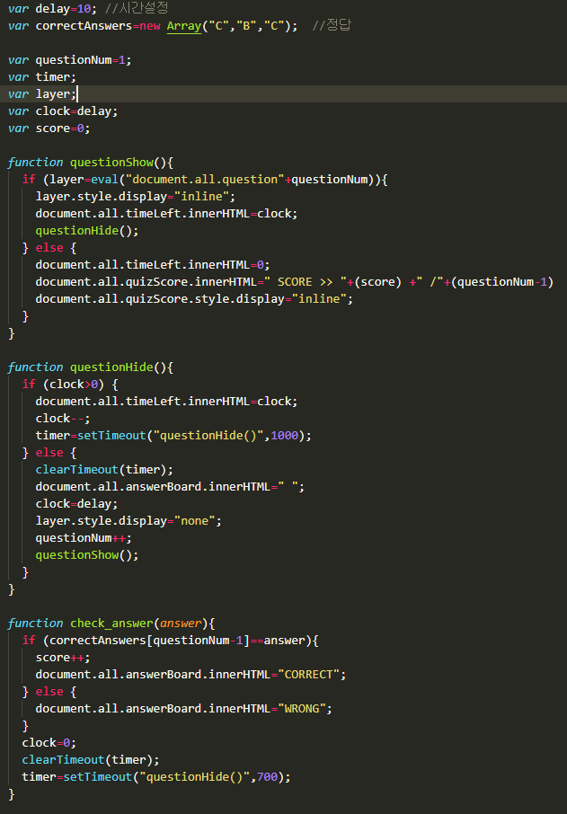
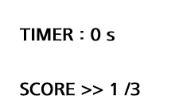
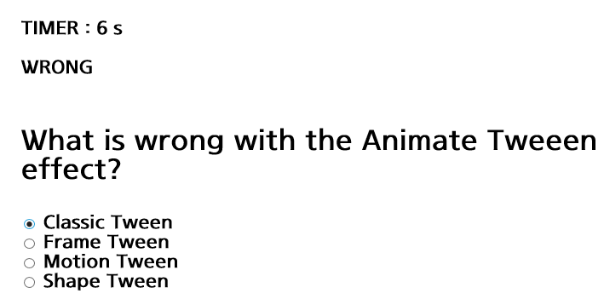
Quiz
Time out Quiz - JS

Slide 12
Thanks for watching

